Slide 1
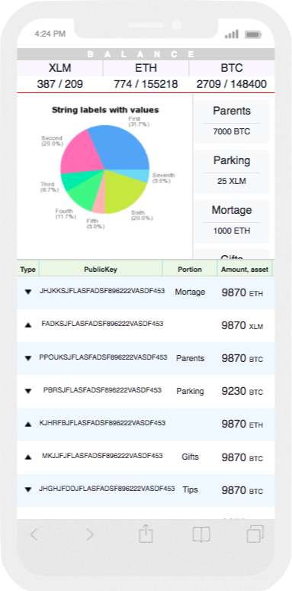
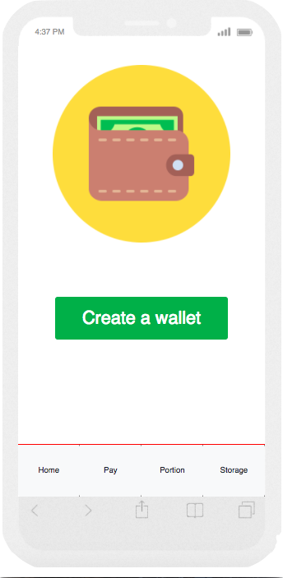
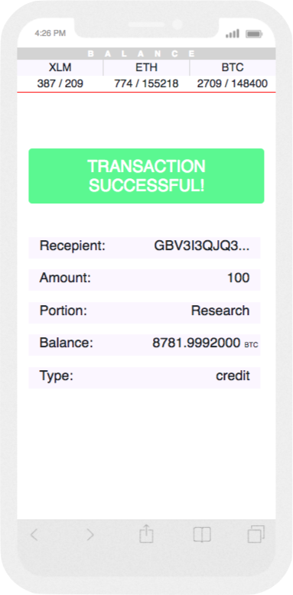

BANKLESS
SMART WALLET - KEEP YOUR CRYPTO UNDER CONTROL
team “Smoke and Mirror”

Slide 2


PROBLEM REVEALED
TRANSACTION RESTRICTION
TRANSACTION COST
TRANSACTION
TIME
MAIN CHALLANGES

Slide 3
APROACHES
MOBILE FIRST
INTERFACE
FREINDLY
PROVIDE THE BEST EXPERIENCE FOR USER TO HAVE HIS WALLET AT HAND AT ANY TIME HE/SHE NEEDS
PROVIDE AN OPPORTUNITY NOT ONLY HOLD FINANCIAL FUNDS BUT MANAGE AND INVEST
INFORM USER ABOUT ANY CHANGES USING MESSAGE SERICE “TWILLIO"
USED TO SOLVE THE ISSUE

Slide 4
RESULTS
ACHEIVEMENT
ACHEIVEMENT
ACHEIVEMENT
MODULE
GET RID OF MIDDLE MAN AS A BANKS FROM THE CHAIN
STELLAR
DRASTICALLY INCREASE SPEED OF TRANSACTION AND DECREASE COST
BLOCKSTACK
KYC CONCEPT
AND SECURITY ON BASE OF BLOCKCHAIN
BE READY FOR A FUTURE OF MONEY

Slide 5
FUTURE
INVESTMENT
SERVICES AND
E-COMMERCE
PROVIDE A FUTURE OF TRANSACTIONS

Slide 6







ARCHITECTURE

